Slide 1
Digital Portfolio
STUDENT NAME: DHARHSINI T
REGISTER NO : 2428CO469
NMID: 27280AA6F18645F999742B38ED971BD3
DEPARTMENT: B.Sc.Artifical Intellegence & Machine Learning
COLLEGE: KPR College of Arts Science & Research

Slide 2
PROJECT TITLE
Student Exchange
Program Portfolio

Slide 3


AGENDA
Problem Statement
Project Overview
End Users
Tools and Technologies
Portfolio design and Layout
Features and Functionality
Results and Screenshots
Conclusion
Github Link
3/21/2024 Annual Review

Slide 4

PROBLEM STATEMENT
Students often lack a creative and structured way to showcase their exchange program experiences. This project solves that by building a digital portfolio using HTML, CSS, and JavaScript to present their journey, achievements, and reflections interactively.

Slide 5

PROJECT OVERVIEW
The Student Exchange Program Portfolio is a web-based project designed to help students document and showcase their international exchange experiences in a visually engaging and interactive format. Built using HTML, CSS, and JavaScript, the portfolio allows users to present academic achievements, cultural immersion, personal growth, and reflections through multimedia content and dynamic design.
This digital portfolio serves as both a personal archive and a professional presentation tool, enabling students to share their journey with peers, educators, and future employers in a modern and compelling way.

Slide 6

WHO ARE THE END USERS?
End-Users: Exchange students, university staff, employers, future applicants, and family—anyone interested in viewing or evaluating the student's experience.
Admins: Admins manage the platform by handling user accounts, reviewing content, maintaining system performance, and providing support to students.

Slide 7

TOOLS AND TECHNIQUES
HTML
CSS
JavaScript
VS Code
Git & GitHub

Slide 8
POTFOLIO DESIGN AND LAYOUT
1. Header
Logo or name of the student
Navigation bar with links to: Home, About, Experience, Gallery, Contact
2. Home Section
Hero image (e.g., host country or student photo)
Welcome message or tagline
Smooth scroll button to explore the portfolio
3. About Me
Profile photo
Short bio: name, university, major
Purpose of joining the exchange program
4. Exchange Experience
Timeline or cards showing key events
Academic highlights
Cultural immersion stories
5. Achievements
Certifications, awards, skills gained
Icons or badges for visual appeal
Design Elements
Responsive Layout using CSS Grid or Flexbox
Consistent Color Scheme reflecting the theme of the exchange
Typography with readable and modern fonts
Animations for smooth transitions and hover effects
Media Queries to ensure mobile compatibility

Slide 9
FEATURES AND FUNCTIONALITY
Features: The portfolio includes responsive design, interactive navigation, photo/video gallery, contact form, and testimonial slider.
Functionality: It uses HTML for structure, CSS for styling, and JavaScript for interactivity like form validation and dynamic content.

Slide 10
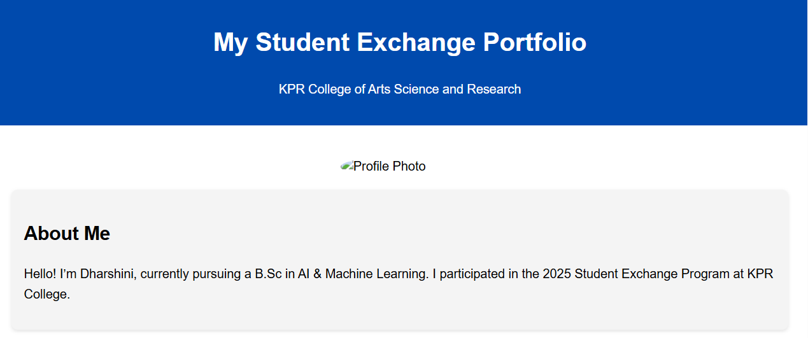
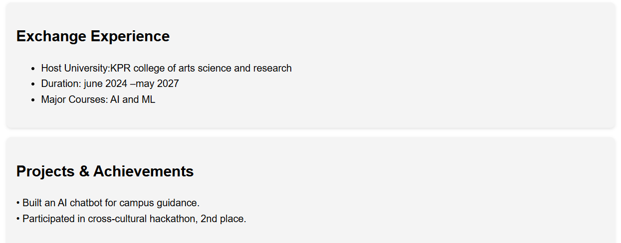

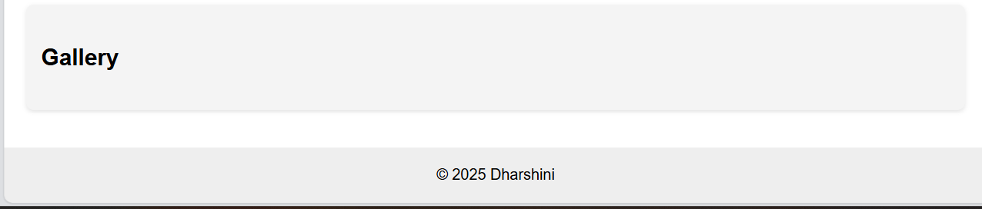
RESULTS AND SCREENSHOTS
3/21/2024 Annual Review

Slide 11
CONCLUSION
The Student Exchange Program Portfolio provides a creative and interactive way for students to document and share their international experiences. By using HTML, CSS, and JavaScript, the project transforms traditional reporting into a dynamic digital showcase that highlights academic achievements, cultural immersion, and personal growth. This portfolio not only serves as a lasting memory of the exchange journey but also enhances the student’s professional profile for future opportunities.
Let me know if you'd like this tailored for a presentation slide or report format!

